Slide 1


Silver Sands for General Trading and General Services Co. Ltd.
SSG
Silver Sands Group
Jan 4th 2024
Company profile Introduction
WIN‐WIN COOPERTION MUTUAL BENEFIT

Slide 2
银沙综合贸易与综合服务有限公司
SSG
银沙集团
2024年1月4日
公司简介
合作共赢，互惠互利

Slide 3

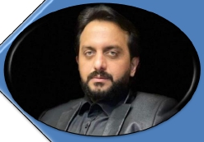
Silver Sands for General Trading and General Services Co. Ltd.
The Chairman’s Message
Ahmed Adil Al-Oqla
SSG Company is a fully-owned subsidiary by Al- OQLE, it has an Iraqi-
based foundation. It was established In the early Twenty to cater to the
urgent needs for re-construction. Then, it developed Into a reputed
professional enterprise that captivated the respect and trust of the
Iraqi ministries, government, civil construction communities, and
agencies.
SSG Company has a diversity of expert staff recognizes the sectors in
which its customers operate, understands their needs, and offers the
most innovative and appropriate services, with the right analyses and
strategies through a highly competent management team.
Our staff is very well experienced in living and working everywhere in
Iraq regions local environment, and possess extensive knowledge in
managing work-related to security challenges and in adapting to the
highest construction international standards.
SSG Company will remain committed to performing all of its activities in
a secure, safe, efficient manner, and so that it can work very positively
to improve the lives of the people of Iraq through engineering and
constructing projects that provide reliable electricity, clean water,
environmentally healthy sanitation services, and residential
infrastructure.

Slide 4
银沙综合贸易与综合服务有限公司
董事长致辞
Ahmed Adil Al-Oqla
SSG是一家由Al-OQLE成立的全资子公司，其总部位于伊拉克。该公司成立于二十世纪初，旨在应对重建的迫切需要。随后，它发展成为了一家声誉卓著的专业化企业，赢得了伊拉克各部委、政府、民间建设团体和机构的尊重和信任。
SSG拥有各种各样的高端人才，对客户经营的各行业了如指掌，了解他们的需求，并建设有一个高素质管理团队，通过正确的分析和战略，为客户提供最具创新和贴切的服务。
我们的员工在伊拉克各地的生活和工作方面都有着丰富的经验，并在管理与安全挑战相关的工作和适应最高的国际建设标准方面拥有广泛的知识。
SSG将继续致力于以稳妥、安全、高效的方式开展所有活动，以便通过（能提供可靠电力、清洁水、环境卫生服务和住宅基础设施的）工程和建设项目积极地改善伊拉克人民的生活。

Slide 5

Silver Sands for General Trading and General Services Co. Ltd.
CONTENT
1
2
3
4
5
6
7
8
9

Slide 6
银沙综合贸易与综合服务有限公司
目录
1
公司简介
2
服务及工程范围
3
服务及工程图
4
公司证书
5
组织构架
6
客户授权
7
产品证书
8
市场开发
9
客户&合作伙伴

Slide 7



Silver Sands for General Trading and General Services Co. Ltd.
Company Profile

Slide 8
银沙综合贸易与综合服务有限公司
公司简介

Slide 9


silver Sands Group
SSG has vision to offer an unparalleded opportunity to create and deliver a legacy that generations will remember
SSG vision was to retain effectively Iraqi Engineers and the labor workforce gainfully employed ,not just for one
project but throughout their lives
SSG vision became a reality as Iraqi contractors were able to contribute in many fields includings bridges ,tunnels
and Airports all over IRAQ
SSG has vision in building ,maintenance ,operation of power plants ,construction and commissioning of power
substations overhead and underground feeder transmission lines , oil , gas facilities, communication systems
,commercial&residential development ,infrastructure ,watersupply , distrivution , treatment and waste water
systems
SG staff in Kuwait, U.A.E, China and Iraq contribute to keep the client abreast with delivery status once/ twice daily via email/SMS
texts. All along stay with the customer. Integrate the global resources to meet the customer need high-authority.
Conduction of de-stuffing industrial structural cargo from open top containers and heavy machinery on flat bed..
We can offer you unskilled Iraqi labor and Iraqi cranes/forklifts when in need. As a value added service. Iraqi trucks can be arranged
1.
2.
3.
4.
5.
6.
7.
with a day’s notice to move equipment from camp to camp within Iraq.
Since the last quarter of 2014, we have run several successful missions to north of Iraq with an associate transporter who
possess own transporting equipment and bonded

Slide 10
银沙集团（SSG）
SSG的愿景之一是提供一次前所未有的机会去创造和兑现一份能让世代得以记住的遗产。
SSG的愿景之二是尽全力留住聘用的伊拉克工程师和劳动力，不仅仅是为了某个项目，而是为了他们的一生。
随着伊拉克承包商能够在包括伊拉克各地的桥梁、隧道和机场在内的许多领域做出贡献，SSG的愿景变成了现实。
SSG在电厂的建造、维护、运营、变电所架空和地下馈线、石油、天然气设施、通信系统、商业和住宅开发、基础设施、供水、分配、处理和废水处理系统的建设和调试方面具有远见。
SSG在科威特、阿联酋、中国和伊拉克的员工会每天一次/两次通过电子邮件/短信向客户汇报交付情况，并时刻与客户保持联系。SSG整合全球资源，以满足客户的不同需求。
在水平层从开顶式集装箱拆装工业结构货物和重型机械。
在需要的时候，我们可以为您提供伊拉克非技术工人和伊拉克起重机/叉车，其作为一项增值服务。伊拉克卡车可以在收到通知的一天内安排在伊拉克境内的各个营地之间运送设备。
自2014年第四季度以来，我们已经与一个拥有运输设备和保税的联营运输公司合作成功地在伊拉克北部执行了几次任务。

Slide 11

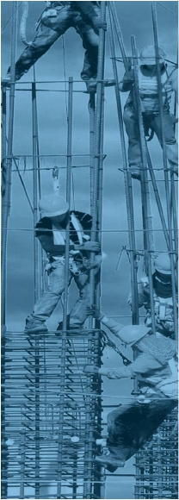


Silver Sands for General Trading and General Services Co. Ltd.
OUR VISION
To be world-class engineering and contracting company, and delivering solutions while maintaining
international
standards, safety, integrity, and ethics.
Environment: eliminating the damages which may affect our employees, clients, third persons, property, and environment
stands as a major principle that we strictly follow.
Therefore we ensure
the
participation of
our
employees
in
sharing and understanding the HSE-QA/Health, Safety,
Environment, Quality Responsibility, and awareness at all corporate levels.
Human Resources: To be a member of SSG Company is to believe that there is no limit to what a human being can achieve.
It is to believe that proper use of technology and science leads to recognizing the importance and the necessity of developing
human skills through continuous education
OUR MISSION
To be the leading premier engineering, construction, and projectmanagement company within the areas in
which we operate.
Committed to making a positive impact in the communities and environment In which we operate. Our people
will be involved in community-based initiatives creating benefits for the community andour people.

Slide 12
银沙综合贸易与综合服务有限公司
我们的愿景
成为世界一流的工程和承包公司，并在保持国际标准、安全、诚信和道德的前提下向客户提供解决方案。
我们的价值观
环境：消除可能对我们的员工、客户、第三方、财产和环境造成的损害是我们严格遵循的主要原则。
因此，我们确保我们的员工参与到分享和理解公司各个层面的HSE-QA/健康、安全、环境、质量责任和意识。
人力资源：要成为SSG的一员，就要相信一个人所能取得的成就是无止境的。
要相信，正确使用技术和科学可以使人们认识到通过继续教育发展人类技能的重要性和必要性
我们的使命
在我们的业务范围内，成为首屈一指的工程、建设和项目管理公司。
致力于对我们所处的社区和环境产生积极的影响。我们的员工将参与到以社区为基础的倡议中去，从而为社区和人民创造利益。

Slide 13
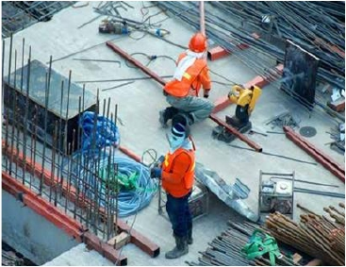
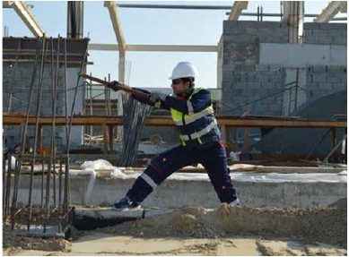
Silver Sands for General Trading and General Services Co. Ltd.
Committed to creating opportunities to improve the environment in a sustainable manner.
Support our team by training, rewarding, and retaining, and by providingapositiveworkenvironment,
development,fairlaborpractices.
We will integrate global and local perspectives, promote solid management of resources, and contribute to a
better quality of life.
To anticipate the needs of our customers and partners, and to deliver on the promise that we commit.
To work towards making communities regard us as responsible and a responsive entity committed to our
client’s satisfaction.
To strive to earn the trust of clients and our employees not only for theresults we achieve but the added value
that we provide In achieving them.
We maintain the highest standards of governance, ethics. Conduct business In an open, honest and ethical
way.

Slide 14
银沙综合贸易与综合服务有限公司
致力于创造机会，以可持续发展的方式改善环境。
通过培训、奖励和留住人才，以及提供积极的工作环境、发展空间和公平的劳动实践来支持我们的团队。
我们将结合全球和当地情况促进资源的坚实管理，为更好的生活质量作出贡献。
预测客户和合作伙伴的需求，并兑现我们的承诺。
努力让社区将我们视为一家负责任的和响应客户要求的实体。
努力赢得客户和员工的信任，不仅因为我们所取得的成果，也因为我们在实现这些成果的过程中所提供的附加价值。
我们保持最高的管理标准和道德标准，并以开放、诚实和道德的方式开展业务。

Slide 15
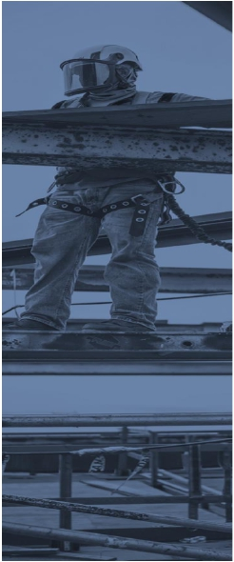
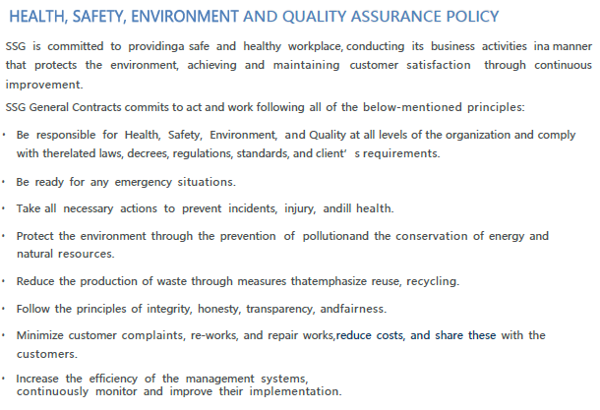
Silver Sands for General Trading and General Services Co. Ltd.

Slide 16
银沙综合贸易与综合服务有限公司
健康、安全、环境与质量保证政策
SSG致力于提供一个安全和健康的工作场所，以保护环境为前提开展业务活动，并通过持续改进实现和保持客户满意度。
SSG总承包商承诺遵循以下所有原则行事和工作：
负责组织各级的健康、安全、环境和质量工作，并遵守相关法律、法令、法规、标准和客户的要求。
为一切紧急情况做好准备。
采取一切必要的行动，以防止事故、伤害和健康损害。
通过防止污染、节约能源和自然资源来保护环境。
通过强调再利用、循环利用的措施减少废物的产生。
遵循正直、诚实、透明、公平的原则。
尽量减少客户投诉、返工和维修工作，降低成本，并与客户分享这些经验。
提高管理系统的效率，并持续监督和改进其实施。

Slide 17
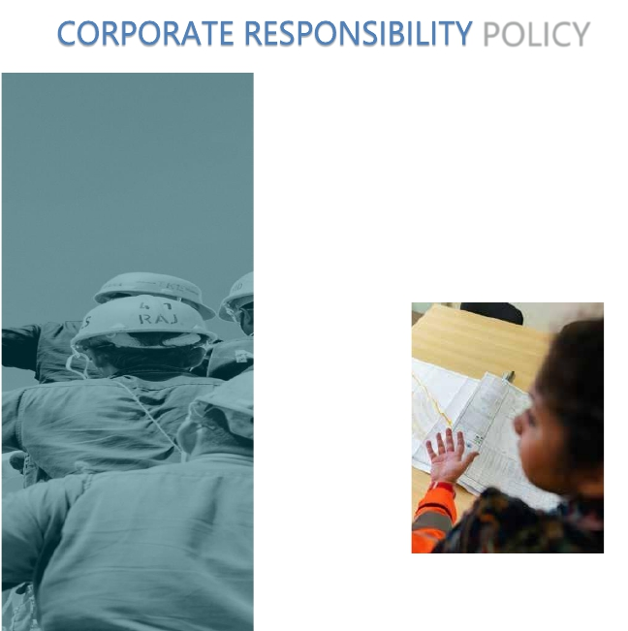
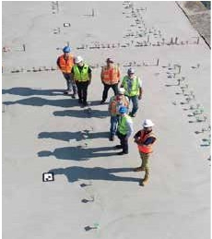
Silver Sands for General Trading and General Services Co. Ltd.
Reference to our business activities and possibilities in trade and construction sector, our company's vision and mission
compromitted in the achievement of possible sustainable development goals on Gender Equality, Decent Work and
Economic Growth, Industry Innovation and Infrastructure, Responsible Consumption, and Production.
The company’s HR policy is to recruit more women and people with disabilities, provide free vocational training programs,
professional development and special comfortable working conditions. More than 35% of office workers are women,
of whom 10% out of 35% are in managerial positions and 3% persons with disabilities.
Our corporate social responsibility (CSR) activities are mainlyrelated to social and environmental projects to reduce the
carbon footprint, philanthropy, including supporting low-income women to start a business

Slide 18
银沙综合贸易与综合服务有限公司
企业责任政策
参考我们在贸易和建筑领域的业务活动和可能性，我们公司的愿景和使命致力于实现性别平等、体面工作和经济增长、产业创新和基础设施、负责任的消费和生产等可能的可持续发展目标。
公司的人力资源政策是招聘更多的女性和残疾人，并为他们提供免费的职业培训计划，专业发展和特殊舒适的工作条件。35%以上的办公室工作人员是女性，其中10%担任管理职位，3%为残疾人。
我们的企业社会责任（CSR）活动主要涉及减少碳足迹的社会和环境项目，以及慈善事业，包括扶持低收入女性创业。

Slide 19
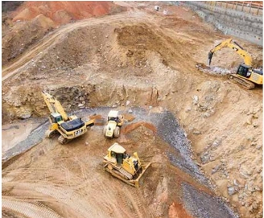
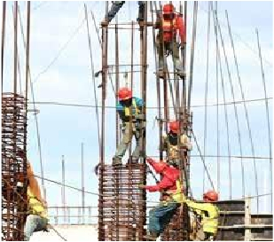
Silver Sands for General Trading and General Services Co. Ltd.
PROJECT CONCEPT ANDUNDERSTANDING
Creation of an integrated and aligned Project team with suitablyqualified personnel
across the organization with an emphasis on:
•
Health, Safety, Security, and
Environment (HSSE).
•
•
•
•
Engineering, supervision, and consultation.
Project delivery, construction management, and schedulecertainty.
Quality and operational reliability.
Maximizing local content.
Will be
achieved
with
the
right
people
and
commitment
to a “One Team” culture

Slide 20
银沙综合贸易与综合服务有限公司
项目概念和理解
在整个组织内建立一个整合的、协调一致的项目团队，由合格的人员组成，其重点放在：
健康、安全、安保与环保（HSSE）。
工程、监督、咨询。
项目交付、施工管理和进度确定。
质量和作业可靠性
最大限度地提高本地化。
以上将通过选择合适的人员和恪守“一个团队”文化的承诺来实现。

Slide 21




Silver Sands for General Trading and General Services Co. Ltd.
SCOP OF Service
1. Light &heavy Equipments /Vehicles
2. Personnel outsourcing
3. Regional &Local
4. Air Freight
5. Land Freight
6. Ocean Freight
7. Project Logistics
8. GCC &Iraq road -Sea -Air Freight -Overland
9. GCC &Iraq road -Sea -Air Freight
10. Packing & Removals
11. Customs Clearance & Delivery
12. Event ,Fairs &Exhibitions
13. Commercial Projects

Slide 22
银沙综合贸易与综合服务有限公司
服务范围
轻型及重型设备/车辆
人事外包
地区&本地
空运
陆运
海运
7. 项目物流
8. 海湾合作委员会&伊拉克公路-海运-空运-陆路运输
9. 海湾合作委员会&伊拉克公路-海运-空运
10. 包装&拆除
11. 清关&交付
12. 活动&会展
13.商业项目

Slide 23

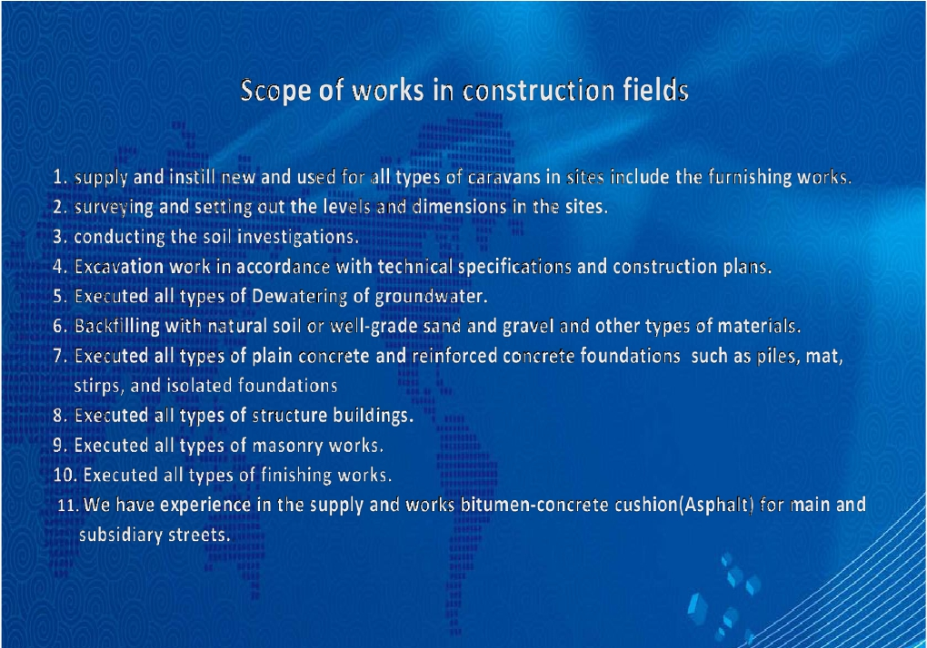
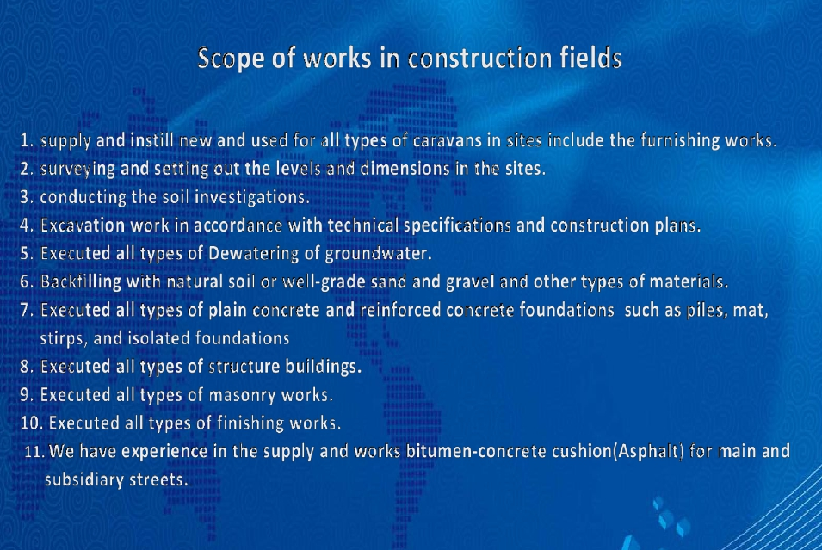
Silver Sands for General Trading and General Services Co. Ltd.
14.

Slide 24
银沙综合贸易与综合服务有限公司
14.
建设领域之工程范围
现场各类新旧大篷车的供应和安装，包括装饰工程。
现场测量和测定水平及尺寸。
进行土壤调查。
按照技术规范和施工计划开展挖掘工程。
实施各种类型的地下水排水。
用天然土壤或优质砂砾等材料回填。
实施各种类型的素混凝土和钢筋混凝土基础，如桩、底板、条形和防震地基。
实施各种类型的结构建筑。
实施各种类型的砌体工程。
实施各种类型的终饰工程。
我们在主干道和副干道沥青混凝土垫层的供应和施工方面有着丰富的经验。

Slide 25
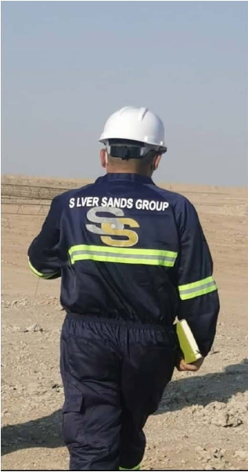
Silver Sands for General Trading and General Services Co. Ltd.
OUR PROJECTS
T
SSG Company takes pride in the quality of work that we
produce. With years of combined industry experience in
construction,
building,
project
management,
our
directors
have
a
thorough
understanding
of the
construction industry. Every project we handle taps into
their industry. A wealth of knowledge and expertise.
Together with
our
competent
and
talented
team
members, we have considerable experience in every facet
of construction.

Slide 26
银沙综合贸易与综合服务有限公司
我们的项目
T
SSG为其实施的工程质量感到骄傲。凭借在施工、建筑和项目管理上多年的行业经验，我们的董事对建筑行业有透彻的了解。我们处理的每一个项目都利用了相应行业方面丰富的知识和专业知识。与我们有能力和才华横溢的团队成员一起，我们在建筑的各个方面都有相当丰富的经验。

Slide 27
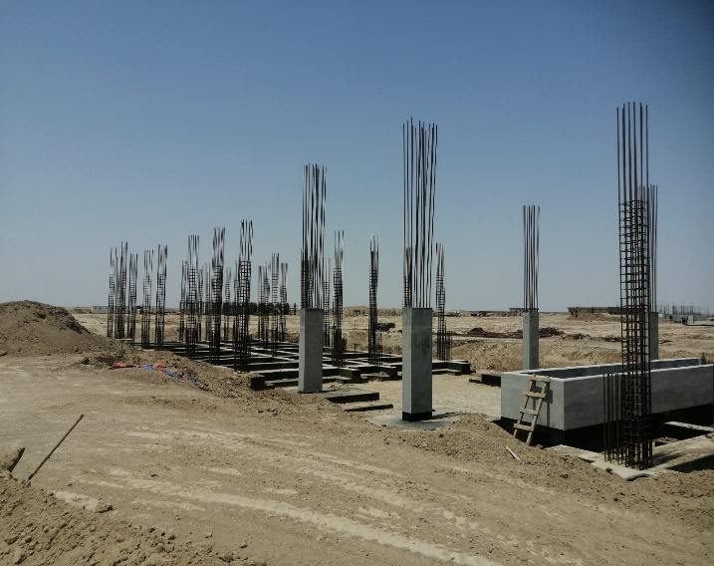
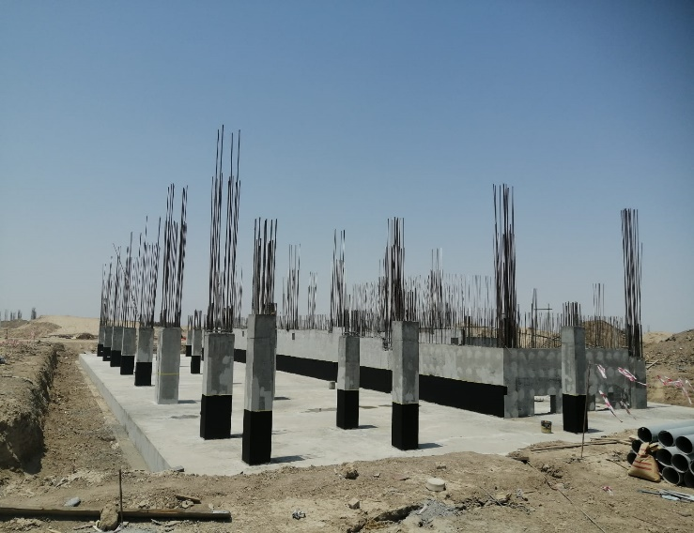
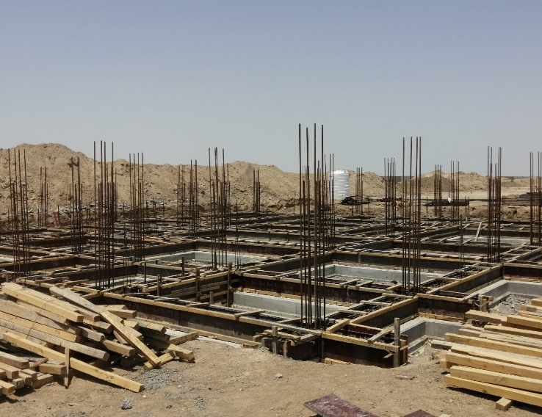
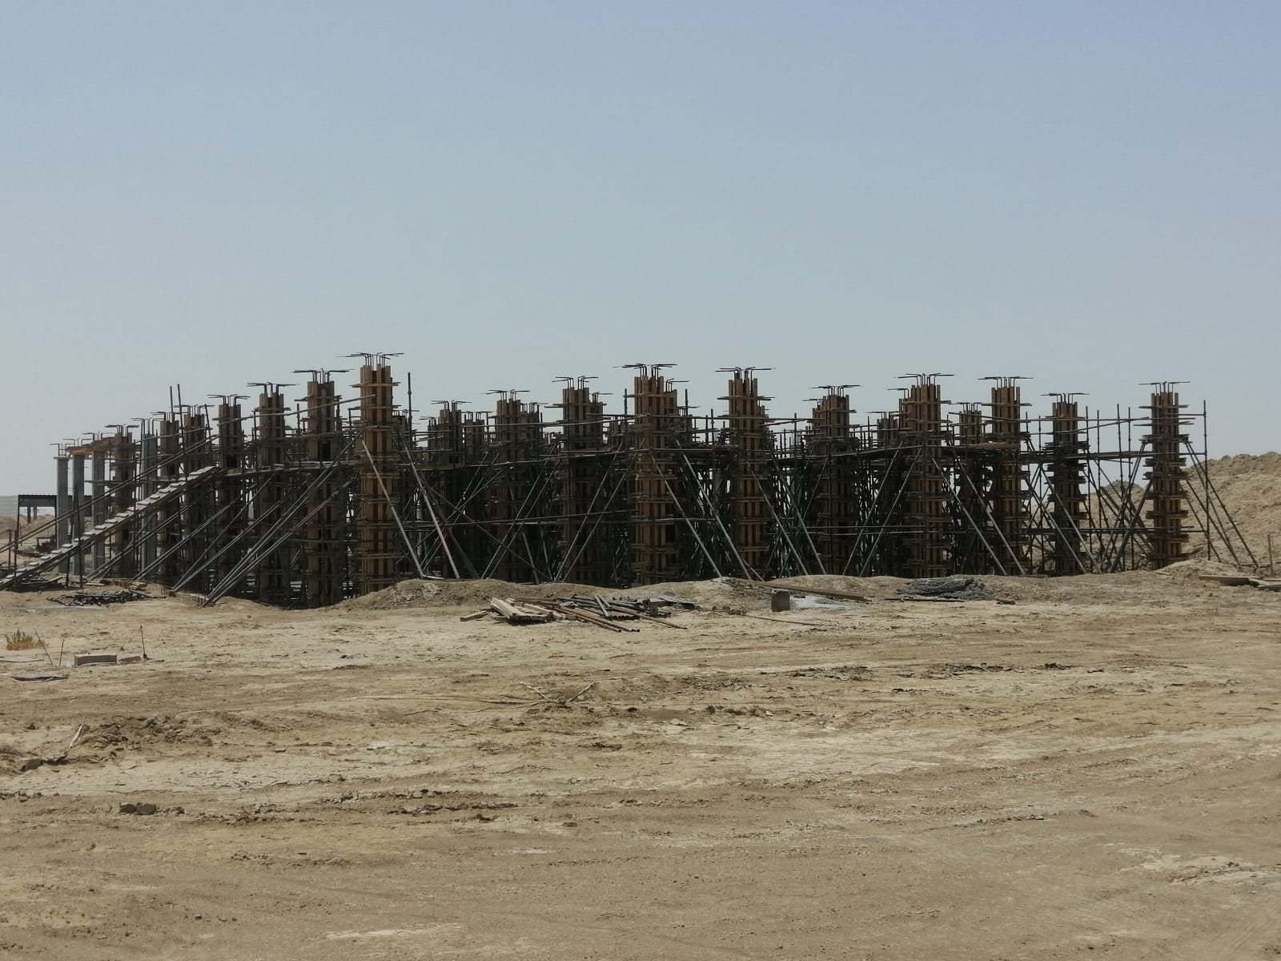
CPP- CONSTRUCTION OF FOUR BUILDINGS TO EPC FOR NEW NASSIRIYA DEPOT PROJECT
Preparing And Implementing Concrete Casting Works For The Foundations And Structure Of The Four Buildings. The Work Includes Preparation Works, Earthworks, And Pouring Concrete Foundations For The Buildings. A Contract Was Signed With The Cpp Company For The Purpose Of Implementing These Works.

Slide 28
CPP- 四栋建筑的施工是新纳西里耶仓库项目的EPC总承包工程的一部分。
为四栋建筑的基础和结构准备并实施混凝土浇筑工程。工作内容包括准备工作、土方工程和建筑物基础的混凝土浇筑。为执行这些工作，已与CPP公司签订合同。

Slide 29
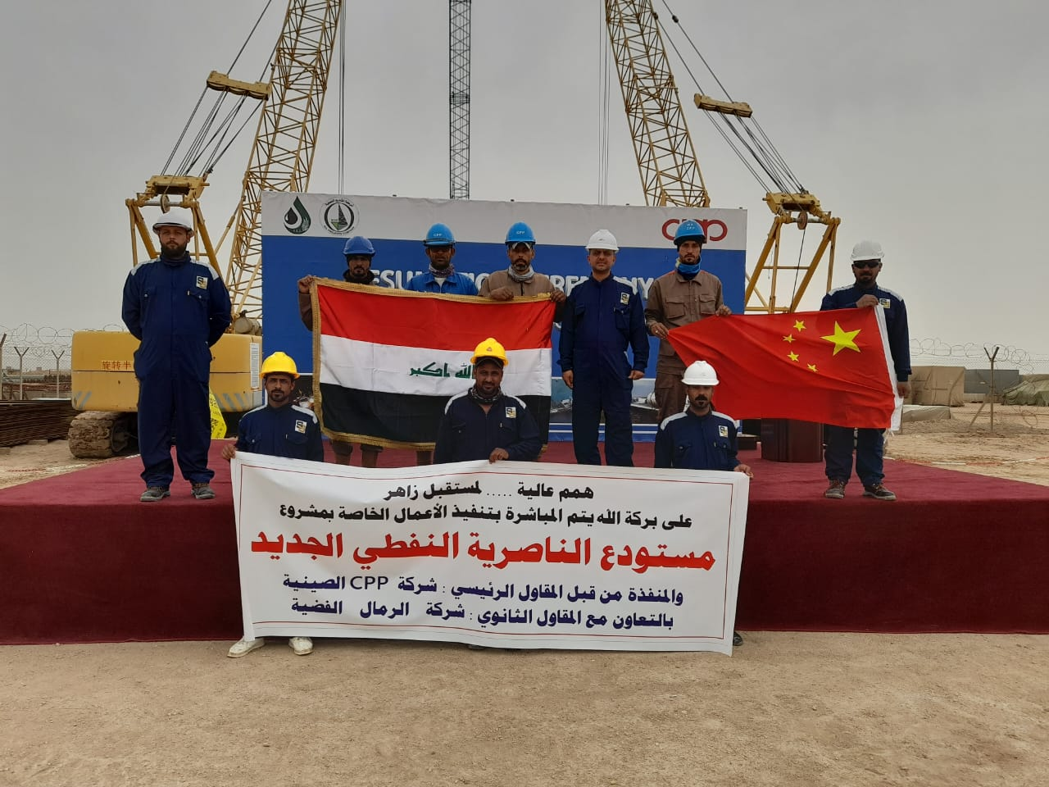
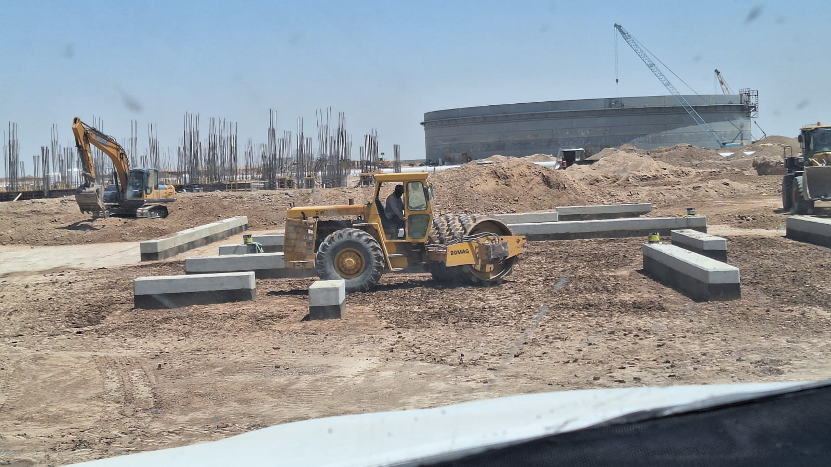
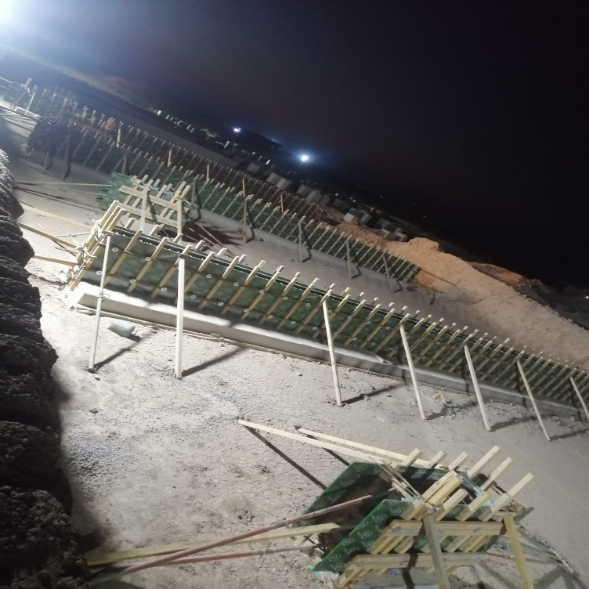
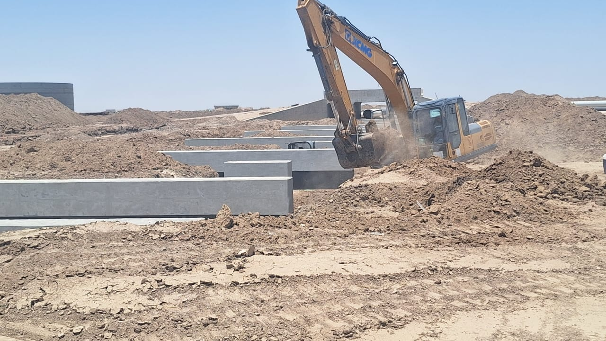
CPP - CONSTRUCTION OF PIPE SLEEPER FOR CRUDE OIL STORAGE TANK AND BOOSTER PUMP AREA
FOR CPP IN NASSRIYAH NEW DEPOT:
SURVEYING & SETTING OUT ,EXCAVATION ,BACKFILLING COMPACTION,SURPLUS SOIL TRANSPORTION TO DESIGNED AREA SUBGRADE TREATMENT WITH SUPBASE EMBEDDED GALVANIZED STEEL PLATES AND ANCHOR BOLTS STEEL BAR WORKS FROM WORKS CONCRETE WORKS COATING WITH BITUMINOUS EMULSION ABOVE GROUND CONCTETE PROTECTION

Slide 30
CPP - 原油储罐和增压泵区域的管道支架施工
针对纳西里耶新仓库的CPP项目：
测量与放线、挖掘、回填压实、将多余土壤运输到指定区域、路基处理、底层嵌入式镀锌钢板和锚栓、钢筋工程、模板工程、混凝土工程、涂覆沥青、地上混凝土保护。

Slide 31
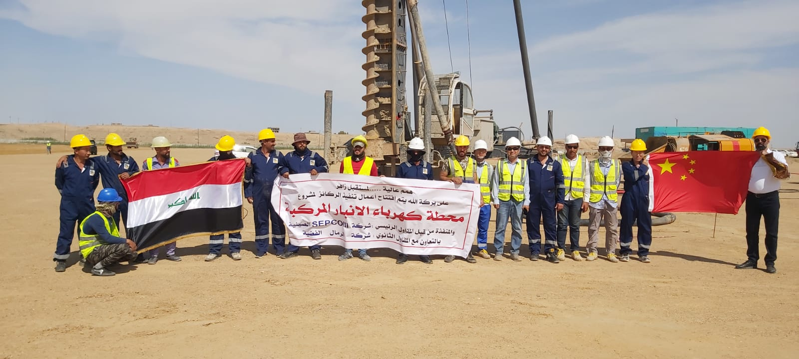
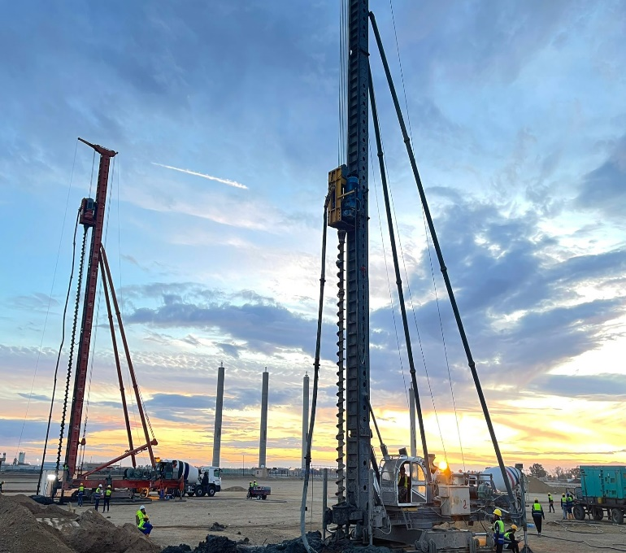
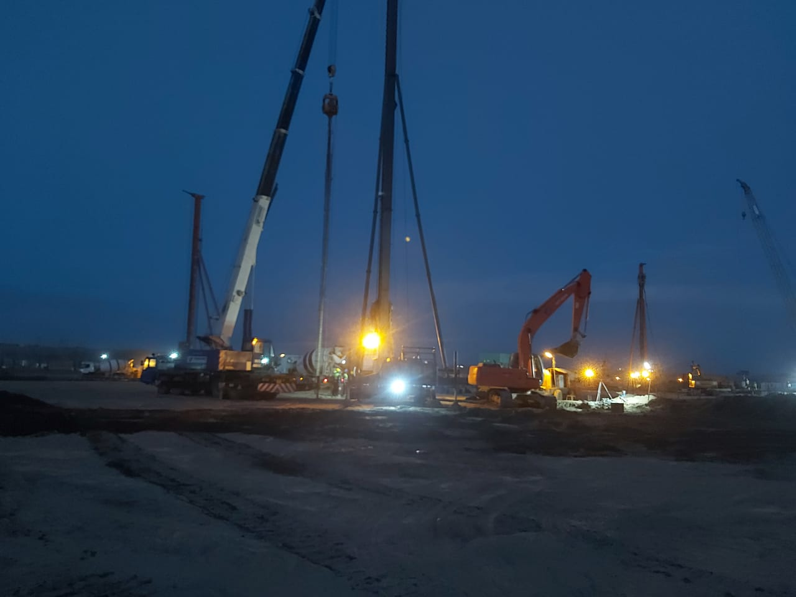
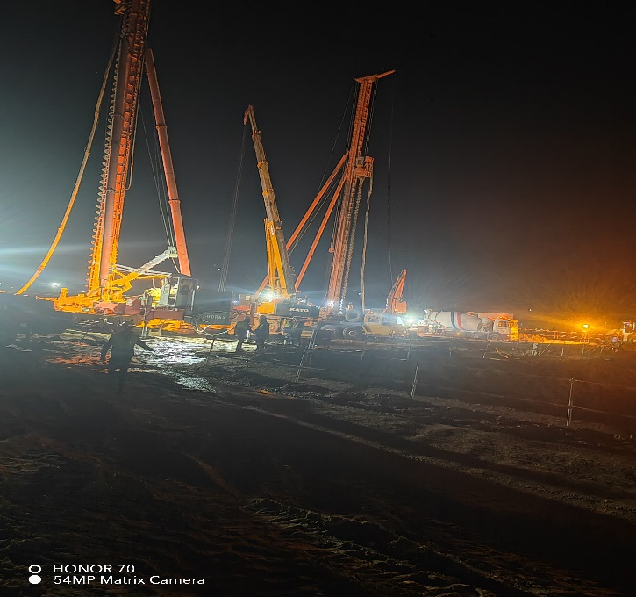
SEPCOIII - AL Anbar Combined Cycle Power Plant Project The Long Spiral Drilling Pumped-Concrete Pile Work

Slide 32
SEPCOIII - 安巴尔联合循环电厂项目中的长螺旋钻灌注混凝土桩工程

Slide 33
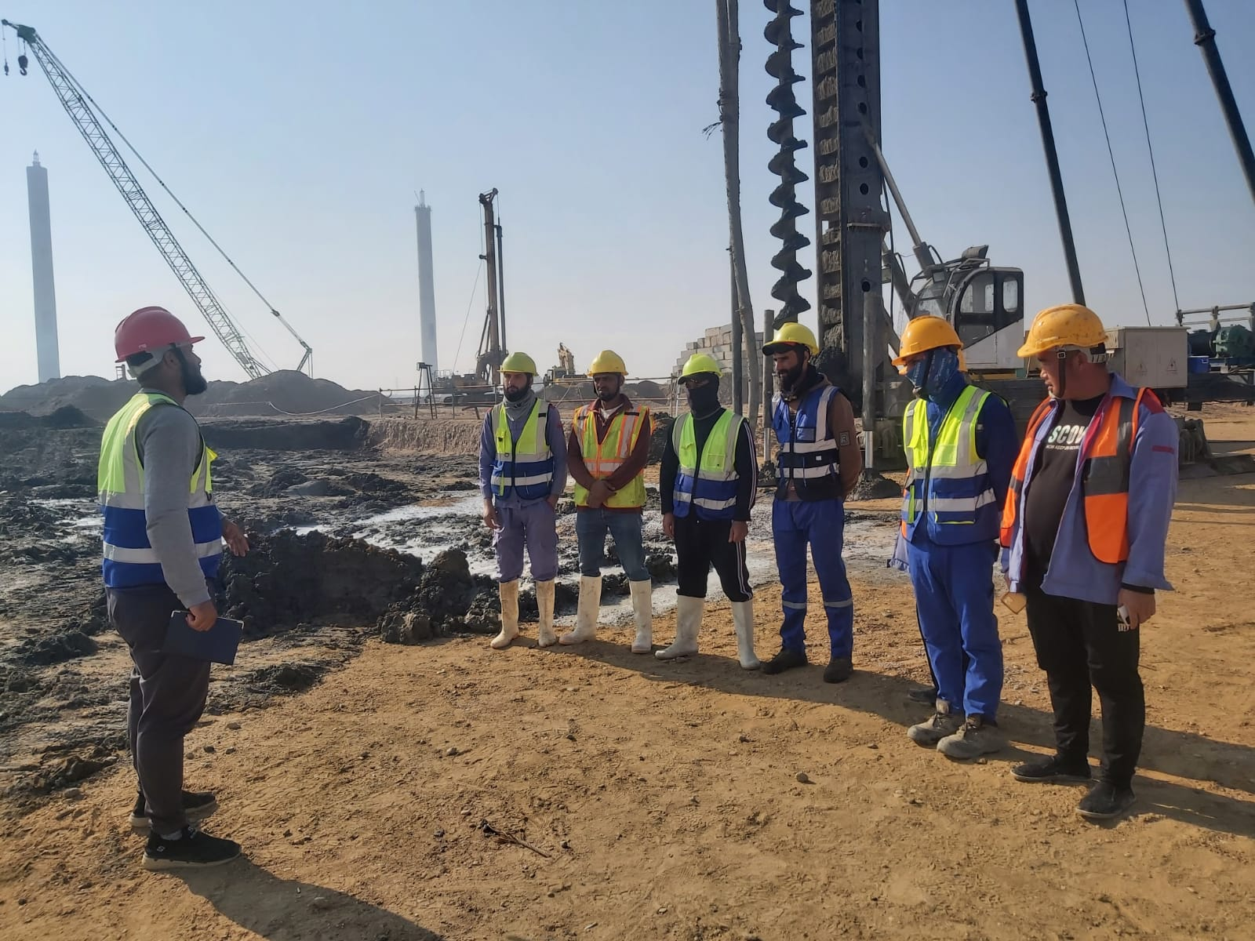
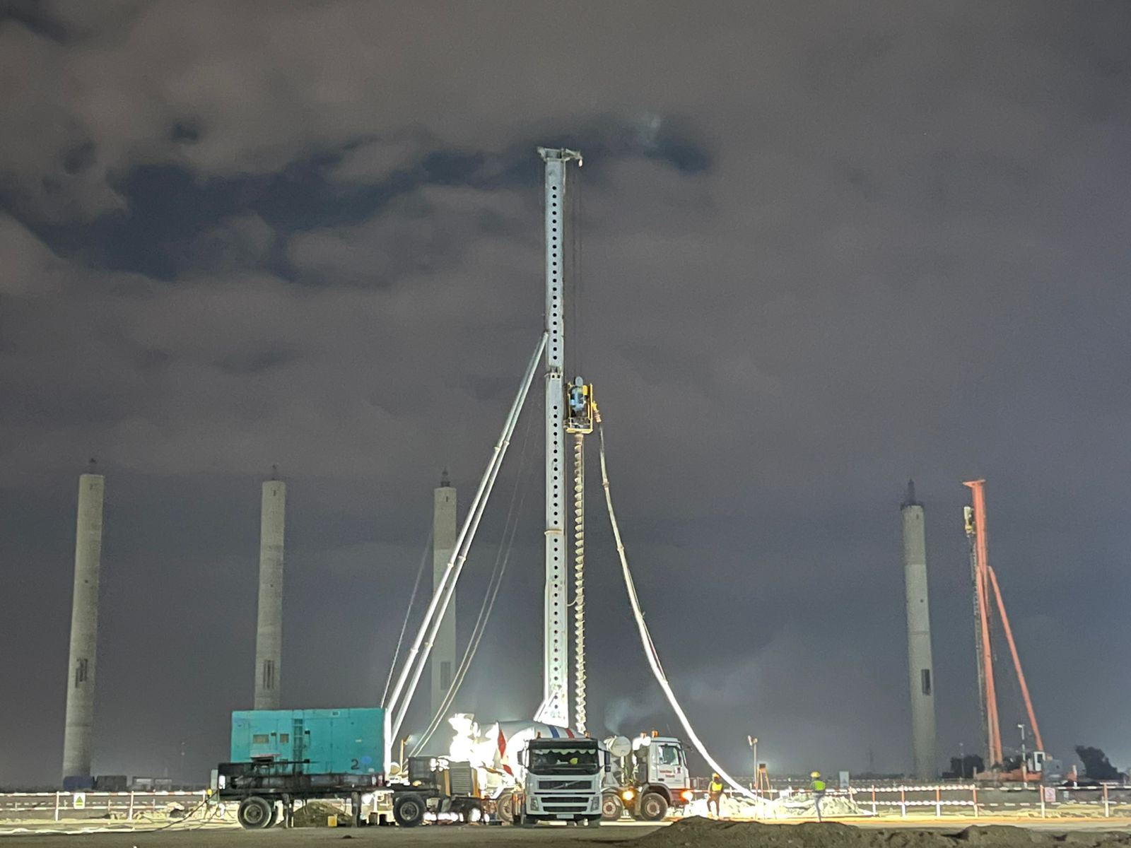
SEPCOIII - AL Anbar Combined Cycle Power Plant Project The Long Spiral Drilling Pumped-Concrete Pile Work
The scope of works is deemed to include, but not limited to, temporary facilities, manpower, water, electrical, machinery, service, permission, construction supply, and installation, provision of all equipment, devices, material, testing, and warranty of the Works as detailed and implied in the Contract documents where the works were executed in accordance with the terms and conditions of the contract with SEPCOIII Company, where 7500 CFG piles and 1500 CFA piles were executed. The work included breaking the pile heads, pile testing with type static load test and integrity piles test , concrete testing and compaction tests after leveling.

Slide 34
SEPCOIII - 安巴尔联合循环电厂项目的长螺旋钻孔泵送混凝土桩施工
工作范围应包括但不限于：临时设施、人员、水、电、机械、服务、许可、施工供应与安装，提供所有设备、装置、材料，进行测试及工程质保等，详见合同文件中的具体和隐含内容。所有工作均按照与SEPCOIII公司签订的合同条款执行，施工过程中完成了7500根CFG桩和1500根CFA桩。工作内容还包括打破桩头、静载荷测试和完整性桩测试、混凝土测试以及平整后的压实测试。

Slide 35
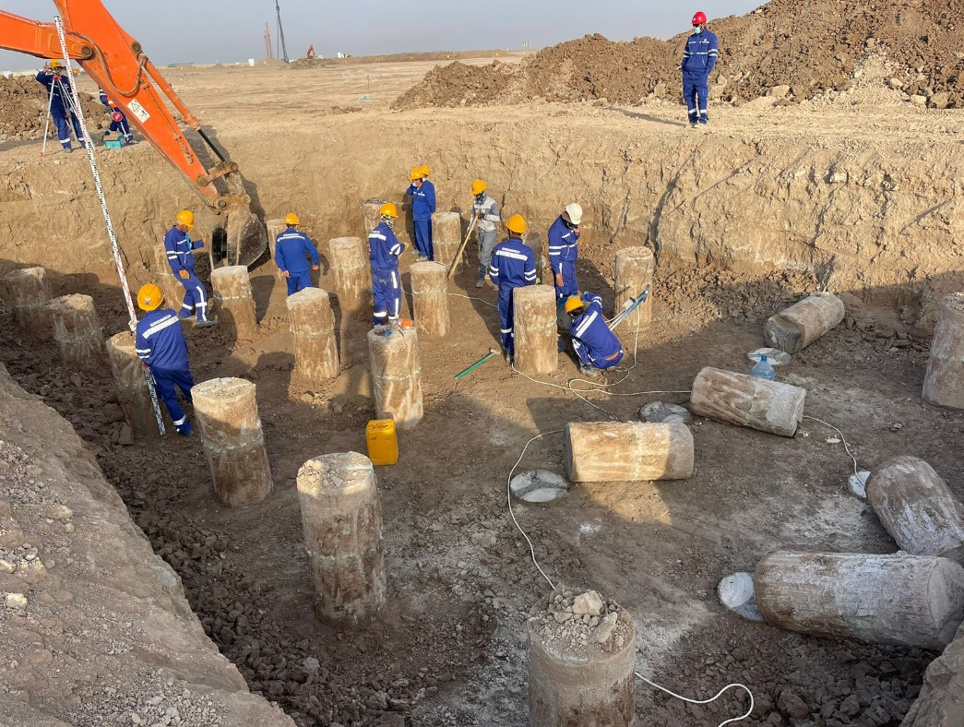
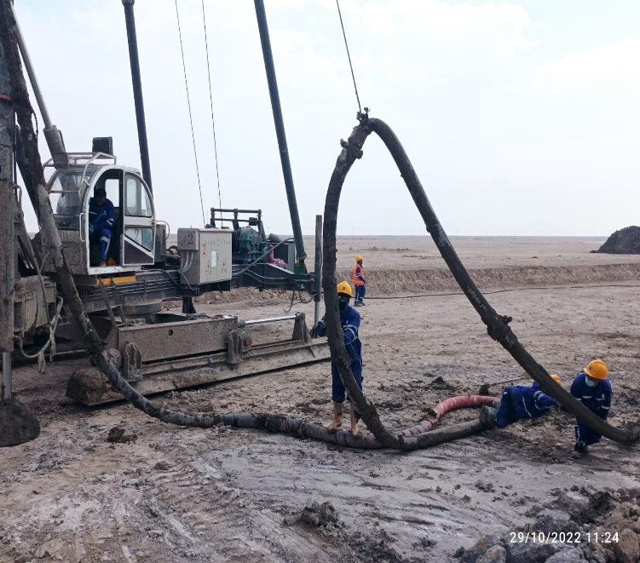
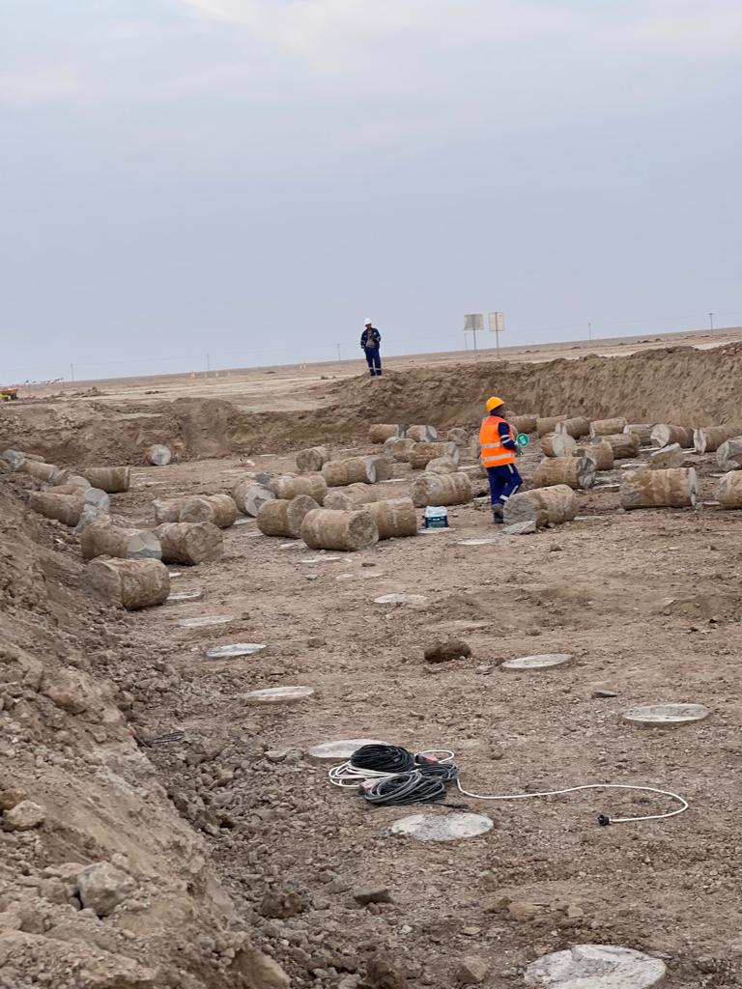
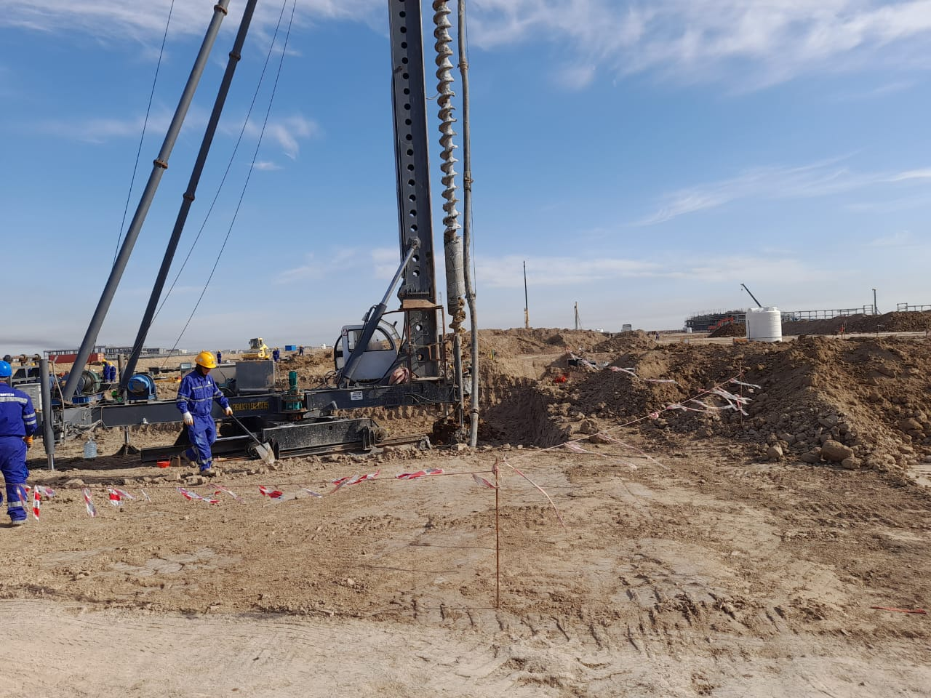
CHINA CAMCE CFG Construction Service for CPF-Oil Treatment System and Auxiliary Systems Project for Block 9 IN BASRAH
The works were executed in accordance with the terms and conditions of the contract with CAMCE Company, where 1300 CFG piles were executed. The work included breaking the pile heads, pile testing with type static load test and intigrity piles test , concrete testing and compaction tests after leveling.

Slide 36
中国CAMCE公司为巴士拉9号区块的CPF原油处理系统及辅助系统项目提供CFG桩施工服务
所有工作均按照与CAMCE公司签订的合同条款执行，施工过程中完成了1300根CFG桩。工作内容包括打破桩头、静载荷测试和完整性桩测试、混凝土测试以及平整后的压实测试。

Slide 37

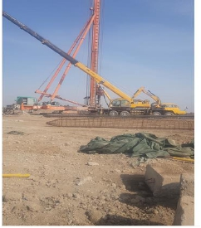
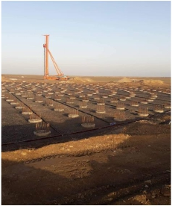
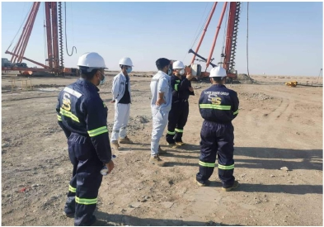
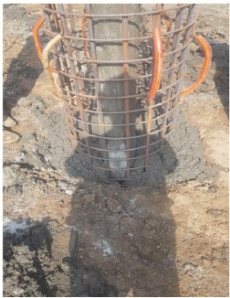
Silver Sands for General Trading and General Services Co. Ltd.
China Petroleum Pipeline Bureau was awarded Provision
of Engineering, Procurement, Construction and Commissioning
of New Nassiriya Crude Oil Depot Project to SSG.
SSG executed a potential Subcontractor to conduct
Piling Works for New Nassiriya Crude Oil Depot.

Slide 38
银沙综合贸易与综合服务有限公司
中国石油天然气管道局将对新纳西里亚油库项目的设计、采购、施工和调试工作安排给SSG进行。SSG指定了一个潜在的分包商，为新纳西里亚油库进行打桩工作。

Slide 39
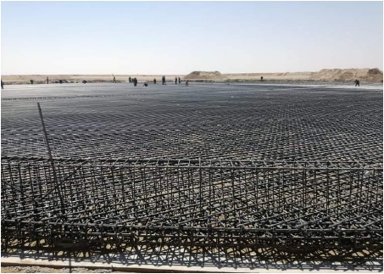
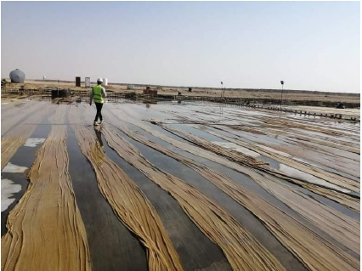
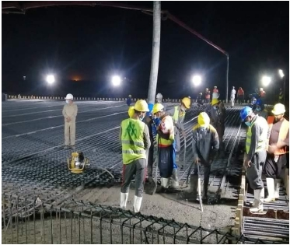
Silver Sands for General Trading and General Services Co. Ltd.
SSG contracted with China Petroleum Pipeline
Bureau (CPP) for Engineering, Construction and
Procurement (EPC) for New Nassiriya Depot
Project to executed 3 Foundations Tank
6000m3 Crude Oil Tanks Foundation of New
Nassiriya Crude Oil Depot Project.

Slide 40
银沙综合贸易与综合服务有限公司
SSG与中国石油天然气管道局（CPP）签订了新纳西里亚油库项目的设计、采购和施工合同（EPC），以执行新纳西里亚油库项目的3个基础，其中包括6000m3原油储罐基础。

Slide 41
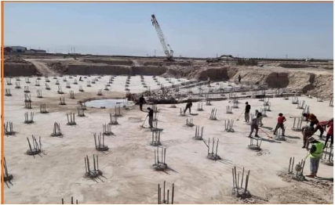
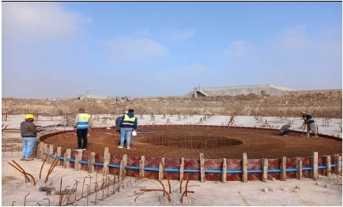
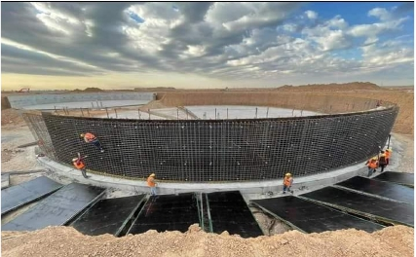
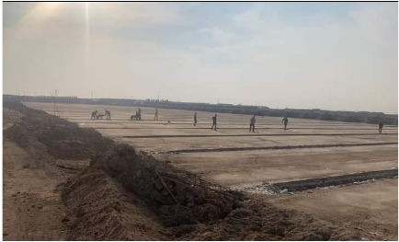
Silver Sands for General Trading and General Services Co. Ltd.
Contracted with China communications Construction Company LTD to executed
the stage four for treatment plant for Hamdan Clarify Center in Basrah Governorate

Slide 42
银沙综合贸易与综合服务有限公司
与中国交通建设股份有限公司签订合同，为位于巴士拉省的哈姆丹净化中心的水处理厂实施第四阶段的工程。

Slide 43
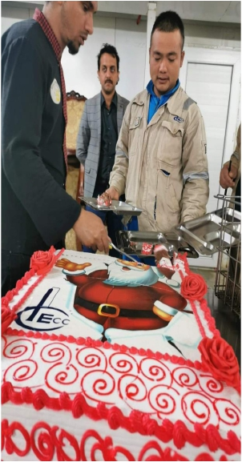
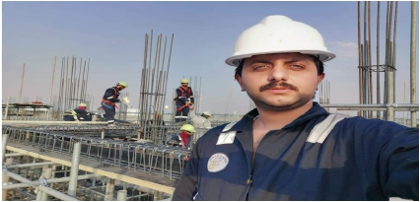
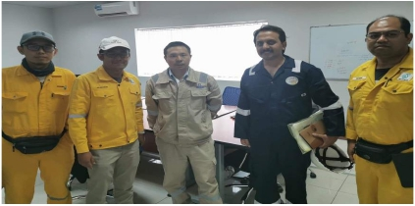
Silver Sands for General Trading and General Services Co. Ltd.
Contracted with CPECC in AL Nasiriyah-AlGraph to
prepare the site, supply the Caravans, and implement all
the soil works from excavation and compacting Natural
soil and well grade degree from sand and gravel.

Slide 44
银沙综合贸易与综合服务有限公司
与位于纳西里耶的中国石油工程建设公司（CPECC）签订合同，准备场地，供应大篷车，并实施所有的土壤工程，包括挖掘和压实天然土壤或优质砂砾。

Slide 45
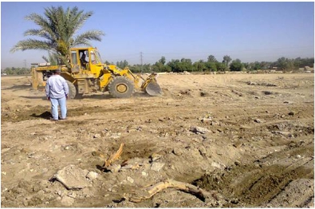
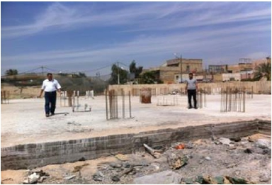
Silver Sands for General Trading and General Services Co. Ltd.
Contract with main contractor (Rodes Company )which contracted with ministry of
education to prepare the site and working in all under ground items including to
implement the raft foundation in 20 schools in Baghdad and 30 School in Anbar.

Slide 46
银沙综合贸易与综合服务有限公司
与总承包商（Rodes公司）签订合同，该公司与教育部签订了合同，在巴格达的20所学校和安巴尔的30所学校实施筏式基础等所有地下项目的准备工作。

Slide 47
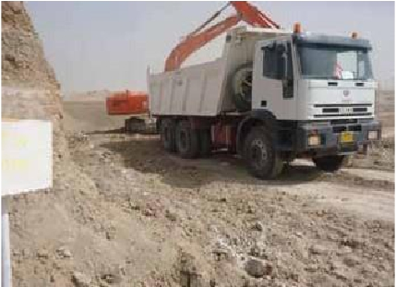
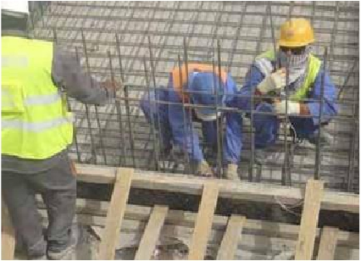
Silver Sands for General Trading and General Services Co. Ltd.
STAGE (2) OF KARDIYAH BRIDGE
Employer and location:
General Committee of Roads and Bridges, Kut
Province, Wassit City, Middle of Iraq
Project Type: EPC
Construction of new highway 20 KM (2-way/4-
lanes each) (53 m wide) with 3 – overpass
bridges in Kut and Badra intersections on the
highway of Baghdad-Kut-Emarah.

Slide 48
银沙综合贸易与综合服务有限公司
卡迪亚大桥的第二阶段
雇主和位置：
伊拉克中部瓦西特省库特市道路和桥梁总务委员会
项目类型：EPC
在巴格达-库特-伊玛拉高速公路的库特和巴德拉十字路口建设20公里(2车道/4车道)(53米宽)的新公路，并修建3座立交桥。

Slide 49
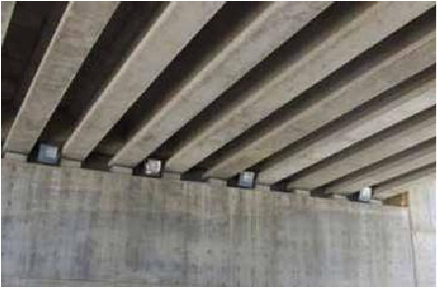


Silver Sands for General Trading and General Services Co. Ltd.
AL-YARMOUK INTERSECTION AND ROUNDABOUT
Employer and location:
Ninawa Roads and Bridges Directorate, Ninawa
Province, Mousel City
Project Type:
EPC
Construction of Al-Yarmouk Intersection
and roundabout (02 Nos.), Overpass + Pass by
Bridges and one Tunnel

Slide 50
银沙综合贸易与综合服务有限公司
耶尔穆克十字路口和环岛
雇主和位置：
尼尼微省摩苏尔市尼尼微公路和桥梁理事会
项目类型：EPC
建设耶尔穆克十字路口和环岛(02号)、立交桥、过街天桥和一个隧道

Slide 51


Silver Sands for General Trading and General Services Co. Ltd.
MAINTENANCE WORKS OF MOHAMMED AL-QASIM HIGHWAY
Employer and location:
Mayoralty of Baghdad - Projects Department –
Baghdad, Iraq
Project Type:
EPCM
All surveys, land works, and civil works on-site
for the maintenance of Mohammed Al-Qasim
Highway 32 wide bridge instruct and pave
approaches including recommended actions for
rehabilitation with the issuance of overall reports.

Slide 52
银沙综合贸易与综合服务有限公司
穆罕默德·卡西姆公路维修工程
雇主和位置：
巴格达市长 - 项目部 - 伊拉克巴格达
项目类型：EPCM
穆罕默德·卡西姆公路32号宽桥维修的所有测量、土地工程和土建工程现场指导和铺路方法，包括全面报告发布后的修复建议行动。

Slide 53



Silver Sands for General Trading and General Services Co. Ltd.
AL- YARMOUK BRIDGE PROJECT
Employer and location:
Ministry of Municipalities and General Public
Works - Ninawa Province - North of Iraq
Project Type:
EPC
The project is the largest bridge intersection
in Iraq, which is implemented by a 100% Iraqi
company.
The Yarmouk Bridge provides an international
transportation service in Nineveh Governorate,
as it includes three crossings, one of which is a
train track, two bridges over each other,
and a two-way tunnel

Slide 54
银沙综合贸易与综合服务有限公司
耶尔穆克大桥项目
雇主和位置：
市政和一般公共工程部 - 尼尼微省 - 伊拉克北部
项目类型：EPC
该项目是伊拉克最大的桥梁交叉口，完全由伊拉克公司实施。
耶尔穆克大桥为尼尼微省提供国际运输服务，因为它包括三个十字路口，其中一个是火车轨道，两座桥相互连接，以及一个双向隧道

Slide 55



Silver Sands for General Trading and General Services Co. Ltd.
THE MODERN VILLAGE COMPLEX IN RAMADI
Employer and location:
Ministry of Agriculture, Anbar Province, Ramadi
City, West of Iraq
Project Type:
EPC
10 Villas Complex Associated with overall
infrastructure and facilities buildings (17 Nos.).

Slide 56
银沙综合贸易与综合服务有限公司
拉马迪现代村庄综合体
雇主和位置：
伊拉克西部安巴尔省拉马迪市农业部
项目类型：EPC
10栋别墅综合体，配套整体基础设施建筑（17栋）。

Slide 57



Silver Sands for General Trading and General Services Co. Ltd.
Contracted with housing and construction
ministry to execud the foundation and
Concrete Structure for Main building following
to Al-shuhdah institution which is following to
prime minister in Baghdad Governorate.

Slide 58
银沙综合贸易与综合服务有限公司
与住房和建设部签订合同，受Al-shuhdah机构之委托负责主建筑的基础和混凝土结构的施工，而该机构是受巴格达省省长之委托。

Slide 59





Silver Sands for General Trading and General Services Co. Ltd.
银沙综合贸易与综合服务有限公司
Supply And Install Mechanical and Electrical Equipments

Slide 60
银沙综合贸易与综合服务有限公司
供应和安装机械和电气设备

Slide 61





Silver Sands for General Trading and General Services Co. Ltd.
银沙综合贸易与综合服务有限公司

Slide 62






Silver Sands for General Trading and General Services Co. Ltd.
银沙综合贸易与综合服务有限公司

Slide 63

COMPANY CERTIFICATE

Slide 64
公司证书
公司章程
银沙综合贸易与综合服务有限公司
公司章程
银沙综合贸易与综合服务有限公司
实收资本：50,000,000IQD（伍仟万伊拉克第纳尔）
第一条：名称：银沙综合贸易与综合服务有限公司
第二条：公司总部：伊拉克-巴士拉/总部有权在伊拉克境内外设立分公司。
第三条：公司宗旨和工程性质：根据《1984年贸易法》第30号文件，并结合本法发出的指示和决定，依法在进出口货物、商品等一般贸易领域进行资本投资，以及为了在公共服务领域提供资本投资，包括为公司活动提供经验、本国和阿拉伯劳动力，并为支持国民经济和国家发展提供工作领域的服务，公司可以通过雇用本国和阿拉伯工人来培训和发展他们，并为本国和阿拉伯公司提供包括清洁、维护和不同的公共服务在内的服务，以帮助公司取得收益和公共利益。
为了达到公司的目的和活动成果，必须做到以下几点：
1 - 持有实现其活动所必需的动产（如各种运输设施——桥梁、仪器和机器等)，并根据有效法律或以后可能出现的法律对其办理所有法律程序。
2 - 持有不动产，并对其办理所有合法和法律程序。
3 - 追踪所有合法的金融交易，并与所有持牌银行进行交易。
4 - 通过建立、购买、出售和与所有公司合并(合资公司除外)，在所有公司中进行投资。
5 - 根据公司的需要和投资人的利益，依法开展各项法律工作。
本合同由提倡者Wattan Tawfeeq Obied整理

Slide 65


COMPANY CERTIFICATE

Slide 66
公司证书
6 - 与社会、合作和私营部门的不同当局或根据法律成立的任何其他组织订立不同类型的合同和达成交易，单独或与他人共同执行其活动和目标。
7 - 在保险公司就其资金、工程、动产或不动产投保，以保护其免受可能发生的损害。
8 - 参与公共、合作、混合和私营部门的所有招标、投标和义务。
9 - 进口与公司活动有关的所有产品。
10 - 开设私人办公室，用于储存、展示或销售公司经营的货物。
11 - 为销售公司经营的货物和商品，按照本公司规定的条件和规定指定相关代理，为本公司服务并实现其目标。
12 - 公司有权拥有适当的商标以实现其目的。
13 - 公司有权代表自己或他人购买、质押和建立必要项目以实现上述目的，并在项目不可用时将其出售。
14 - 购买、投资和租用为达到公司之目的的不同的交通运输设施、机器、起重机及其备件。
15 - 与官方和半官方部门以及公共、混合和私营部门单独或代表它们与他人一起参与所有交易，订立不同类型的合同并签署各种义务、投标和投标，并在公司认为合适的条件下办理所有必要的程序以实现这些目的。
16 - 以某种方式参与自然人和法人可以实现这些目的，包括与其他公司合并，购买他们的股票，贷款票据和根据这方面的有效法律对他们进行承销。
17 - 公司有权在银行开立信用和往来账户，就商业汇票、票据和其他证券（如本票、转让、装船票据和其他文件）制定、撤回、接受或执行任何其他程序。
18 - 根据公司认为合适的条件，从官方机构和银行贷款，可以是将资金作抵押，也可以不作抵押。
19 - 执行公司认为有利于实现其活动目的的所有类型的工作和法律程序。
创始人：
姓名 | AHMED ADIL SABBAR |  |  | 持股数 | 签名
职业 | 自由营业 | 国籍 | 伊拉克 | 50,000,000 | 已签字
身份证号：00636180,2009年11月11日 |  |  |  | 其占资本的比例
地址·国家：伊拉克 - 巴格达 |  |  |  | 100%
城市：巴格达/Al-Maamoon/ 616区/2栋/22号 |  |  |  | 本人保证所提供资料的真实性 已签字/倡导者 Wattan Tawfeeq Obied
第四条：公司资本：
实收资本：50,000,000IQD（伍仟万伊拉克第纳尔）
第五条：创始人：
我们（附表中签名的创始人）已批准本公司成立，其名称及资本上文已列明。我们授权提倡者（Wattan Tawfeeq Obied）和（Haider Khaleel Ibrahim）在公司注册办公室办理公司注册手续，以及到其他相关办公室完成公司注册手续。
公章/伊拉克共和国/贸易部/公司登记部门/认证
代理/创始人代表
姓名：倡导者（Wattan Tawfeeq Obied）
地址：巴士拉/Al-Abasiyah/Saeed Hamid街
电话：07705606080

Slide 67


COMPANY CERTIFICATE
公司证书

Slide 68


COMPANY CERTIFICATE
公司证书

Slide 69


COMPANY CERTIFICATE
公司证书

Slide 70

COMPANY CERTIFICATE
公司证书
Company Official Documents
公司官方文件

Slide 71


COMPANY CERTIFICATE
公司证书

Slide 72


COMPANY CERTIFICATE

Slide 73
公司证书
银沙综合贸易与综合服务有限公司
HSE计划
银沙综合贸易与综合服务有限公司
2019年2月
文件名称：质量手册
序列号：SFI/QM-001
版本/修订：B/1
起草日期：2008年12月24日
修订日期：2012年7月31日
管控专用章：
本文件自批准之日起生效，未经批准不得重印，且加盖灰色重印管控专用章后失效。
编辑：
JONE
审核：
批准：

Slide 74

ORGANIZATION
Manager

Slide 75
组织构架
总经理
审计&控制
执行董事
公共关系
材料部
行政部
项目部
AQ/QC部
安保部
主料经理
供应链
经理部
技术部
安保经理

Slide 76


Customer Authorization

Slide 77
客户授权
中石油国际伊拉克分公司
中石油国际伊拉克分公司
参考编号 | HFO-DL-03726-CPL-2014-Sep
日期 | 2013年9月24日
请求/应答 | 是 否
MOC参考编号
参考编号 | HFO-DL-03747-CPL-2014-Sep
日期 | 2014年9月25日
请求/应答 | 是 否
MOC参考编号
致：南海关总署
致：南海关总署
主题：授权书
主题：授权书
我司（中石油国际伊拉克分公司）特此授权身份证号为:10的Maki Abbas Babi为我公司的清关服务代表，负责处理从Khor AL-Zubair港装运设备材料及收集交货单的相关工作及LEW流程。材料包括（钻杆和钻铤），用于DPSC合同之目的。
商业发票号：20140820BHDC-07
提单号：MY1425XGGZUB10
清关服务代表：银沙公司
进口类型：临时性
我司（中石油国际伊拉克分公司）特此授权身份证号为:10的Maki Abbas Babi为我公司的清关服务代表，负责处理从Khor AL-Zubair港装运设备材料及收集交货单的相关工作及LEW流程。材料包括（修井工具），用于DPSC合同之目的。
商业发票号：20140820BHDC-04
提单号：MY1425XGGZUB04
清关服务代表：银沙公司
进口类型：临时性
谨致问候
Wang Yu
首席HFO
中石油国际伊拉克分公司
仅供清关使用
谨致问候
Wang Yu
首席HFO
中石油国际伊拉克分公司
仅供清关使用
Wang Yu
中石油（海尔法亚）首席HFO
Wang Yu
中石油（海尔法亚）首席HFO
Wang Yu
首席HFO
中石油国际伊拉克分公司
仅供清关使用
Wang Yu
首席HFO
中石油国际伊拉克分公司
仅供清关使用
地址：伊拉克共和国米桑省卡拉区中石油海尔法亚基地
地址：伊拉克共和国米桑省卡拉区中石油海尔法亚基地

Slide 78


Customer Authorization

Slide 79
客户授权
中国石油集团渤海钻探工程有限公司伊拉克分公司
中海油伊拉克有限公司
阿联酋迪拜机场自贸区7WB 3100室
致有关人士
参考编号： | BHDC-WQ-ALCDO-0010
日期： | 2014年10月22日
致有关人士
日期：2014年10月22日
参考编号：DCG/6034
主题： 授权书
主题：授权书
尊敬的先生/女士：
中海油伊拉克有限公司特此授权以下银沙公司之代表：Mustafa Muhsen Jabbar、Amad Kadhum Hussein、Harith Samer Mohammed、Ahamed Adnan Abdul Zahra以及Murtada Muhsen Jabbar为我公司的清关服务代表，负责收集交货单以及处理从Khor AL-Zubair港装运设备材料至位于Buzurgan Terminal的油田现场的相关工作及LEW流程。它们将根据以下信息进行长期进口：
货物描述：固井备件和固井石油化学品
合同编号：TSC/MISSN/2010/CMITWRD-210-PRT-10.53-00151-2
发票号：20140820BHDC-11
提单号：MY1425XGGZUB14
尊敬的先生：
渤海钻探工程有限公司伊拉克分公司特此授权以下银沙公司之代表：Mustafa Muhsen Jabbar、Amad Kadhum Hussein、Harith Samer Mohammed、Ahamed Adnan Abdul Zahra以及Murtada Muhsen Jabbar为我公司的清关服务代表，负责处理LEW流程的相关工作，以及收集来自航运公司以下相关信息之设备的交货单：
1. 设备类型：氯化钙
2. 进口港：Khour AL-Zubair港
3. 发票号：20140820BHDC-09
4. 提单号：MY1425XGGZUB12
Xiong Zhan
总经理
渤海钻探工程有限公司伊拉克分公司
谨致问候
Duan Chenggang
中海油伊拉克有限公司总经理
谨代表中海油伊拉克有限公司
地址：伊拉克共和国米桑省卡拉区海尔法亚油田

Slide 80


Customer Authorization

Slide 81
客户授权
中国石油集团渤海钻探工程有限公司伊拉克分公司
致：科威特能源公司伊拉克分公司
参考编号： | BHDC-SIBA-AL-0012
日期： | 2014年9月25日
主题： 授权书
我司（中国石油集团渤海钻探工程有限公司伊拉克分公司）作为KEIL的承包商，特此请求授权以下人员作为我公司的清关服务代表，负责处理从Khor AL-Zubair港装运设备材料的LEW、清关及相关工作流程，以及收集来自航运公司材料为钻井工具的交货单。
1. 进口港：Khor AL-Zubair
2. 发票号：20140820BHDC-12
3. 提单号：MY1425XGGZUB15
4. 合同编号：KEIL/SIBA/2013/C-025-DRILLING RIG
5. 清关服务代表：银沙公司
6. SRC清关服务代表：Maki ABBAS Babi SC报关员，海关南区10号信。
7. KEC, SIBA Authority, SOC清关服务代表，负责收集交货单和清关：Mustafa Muhsen Jabbar（身份证号：00295676）、Amad Kadhum Hussein（身份证号：01240061）、Abbas Muhsen Jabbar（身份证号：00764135）以及Murtada Muhsen Jabbar（身份证号：00396378）。
8. 进口类型：临时性
地址：伊拉克共和国米桑省卡拉区

Slide 82


Customer Authorization

Slide 83
客户授权
中海油伊拉克有限公司
阿联酋迪拜机场自贸区7WB 3100室
中石油国际伊拉克分公司
致有关人士
日期：2014年10月22日
参考编号：DCG/6034
参考编号 | HFO-DL-03730-CPL-2014-Sep
日期 | 2013年9月23日
请求/应答 | 是 否
MOC参考编号
主题：授权书
尊敬的先生/女士：
中海油伊拉克有限公司特此授权以下银沙公司之代表：Mustafa Muhsen Jabbar、Amad Kadhum Hussein、Harith Samer Mohammed、Ahamed Adnan Abdul Zahra以及Murtada Muhsen Jabbar为我公司的清关服务代表，负责收集交货单以及处理从Khor AL-Zubair港装运设备材料至位于Buzurgan Terminal的油田现场的相关工作及LEW流程。它们将根据以下信息进行长期进口：
货物描述：固井备件和固井石油化学品
合同编号：TSC/MISSN/2010/CMITWRD-210-PRT-10.53-00151-2
发票号：20140820BHDC-11
提单号：MY1425XGGZUB14
致：南海关总署
主题：授权书
我司（中石油国际伊拉克分公司）特此授权身份证号为:10的Maki Abbas Babi为我公司的清关服务代表，负责处理从Khor AL-Zubair港装运设备材料及收集交货单的相关工作及LEW流程。材料包括（钻井设备），用于DPSC合同之目的。
商业发票号：20140820BHDC-01
提单号：MY1425XGGZUB01
清关服务代表：银沙公司
进口类型：临时性
谨致问候
谨致问候
Wang Yu
首席HFO
中石油国际伊拉克分公司
仅供清关使用
Wang Yu
中石油（海尔法亚）首席HFO
Wang Yu
首席HFO
中石油国际伊拉克分公司
仅供清关使用
Duan Chenggang
中海油伊拉克有限公司总经理
谨代表中海油伊拉克有限公司
地址：伊拉克共和国米桑省卡拉区中石油海尔法亚基地

Slide 84


Customer Authorization

Slide 85
客户授权
中国石油集团渤海钻探工程有限公司伊拉克分公司
中国石油集团渤海钻探工程有限公司伊拉克分公司
致有关人士
参考编号： | BHDC-WQ-ALCDO-0010
日期： | 2014年10月22日
致：科威特能源公司伊拉克分公司
参考编号： | BHDC-SIBA-AL-0012
日期： | 2014年9月25日
主题： 授权书
尊敬的先生：
渤海钻探工程有限公司伊拉克分公司特此授权以下银沙公司之代表：Mustafa Muhsen Jabbar、Amad Kadhum Hussein、Harith Samer Mohammed、Ahamed Adnan Abdul Zahra以及Murtada Muhsen Jabbar为我公司的清关服务代表，负责处理LEW流程的相关工作，以及收集来自航运公司以下相关信息之设备的交货单：
1. 设备类型：氯化钙
2. 进口港：Khour AL-Zubair港
3. 发票号：20140820BHDC-09
4. 提单号：MY1425XGGZUB12
主题： 授权书
我司（中国石油集团渤海钻探工程有限公司伊拉克分公司）作为KEIL的承包商，特此请求授权以下人员作为我公司的清关服务代表，负责处理从Khor AL-Zubair港装运设备材料的LEW、清关及相关工作流程，以及收集来自航运公司材料为钻井工具的交货单。
1. 进口港：Khor AL-Zubair
2. 发票号：20140820BHDC-12
3. 提单号：MY1425XGGZUB15
4. 合同编号：KEIL/SIBA/2013/C-025-DRILLING RIG
5. 清关服务代表：银沙公司
6. SRC清关服务代表：Maki ABBAS Babi SC报关员，海关南区10号信。
7. KEC, SIBA Authority, SOC清关服务代表，负责收集交货单和清关：Mustafa Muhsen Jabbar（身份证号：00295676）、Amad Kadhum Hussein（身份证号：01240061）、Abbas Muhsen Jabbar（身份证号：00764135）以及Murtada Muhsen Jabbar（身份证号：00396378）。
8. 进口类型：临时性
Xiong Zhan
总经理
渤海钻探工程有限公司伊拉克分公司
地址：伊拉克共和国米桑省卡拉区海尔法亚油田
地址：伊拉克共和国米桑省卡拉区

Slide 86


Customer Authorization

Slide 87
客户授权
中国石油集团渤海钻探工程有限公司伊拉克分公司
中国石油集团渤海钻探工程有限公司伊拉克分公司
致：卢克石油中东有限公司
收件人：Iskander Nasyrov先生
总经理
抄送： 项目经理
参考编号： | BHDC-WQW-2014-0038
日期： | 2014年10月22日
参考编号： | BHDC-SIBA-LEL-0012
日期： | 2014年9月25日
关于：进口货物、文件跟进和清关之授权
尊敬的先生：
请注意，根据中国石油集团渤海钻探工程有限公司与卢克石油中东有限公司（“LUKOIL”）之间于2013年10月25日订立的合同编号为CY-13-8015-0050之合同为西古尔纳（第二阶段）项目提供完井和修井服务，我司特此授权报关代理公司：银沙公司之员工，依照LUKOIL与中国石油集团渤海钻探工程有限公司之间订立的合同编号为CY-13-8015-0050之合同，于2014年8月20日按发票号：20140820BHDC-09办理货物清运手续。
上述货物将通过Khor AL-Zubair港长期进口到伊拉克。
负责清关文件跟进的授权人员信息如下：
Mustafa Muhsen Jabbar（附身份证号）
身份证号：00295676
电话：+964 7811331333
公司名称：银沙公司
地址：巴士拉省萨夫万
Amad Kadhum Hussein（附身份证号）
身份证号：01240061
电话：+964 7700778114
公司名称：银沙公司
地址：巴士拉省萨夫万
Murtada Muhsen Jabbar（附身份证号）
身份证号：00396378
电话：+964 7709050905
公司名称：银沙公司
地址：巴士拉省萨夫万
负责清关的授权人员信息如下：
Maki Abaas Babi（附身份证号）
身份证号：10
电话：+00964 7801295440
公司名称：银沙公司
地址：巴士拉省萨夫万
主题/钻井工具豁免征款申请
合同编号：KEIL/SIBA/2013/C-025-DRILLING RIG
尊敬的先生：
请知悉，渤海钻探工程有限公司伊拉克分公司（科威特能源公司伊拉克分公司的承包商），目前正着手向SIBA工地进口材料。根据14/SIBA/SOC/2011，KEIL和分包商有权免税进口SIBA油田石油运营所需的所有材料、设施和设备。因此，恳请科威特能源公司伊拉克分公司协助渤海钻探工程有限公司伊拉克分公司向SOC申请以下合同的LEW和清关协助：
1. 货物类型：钻井工具
2. 进口港：Khor AL-Zubair
3. 发票号：20140820BHDC-12
4. 主要合同编号：14/SIBA/SOC/2011
5. 分包合同编号：KEIL/SIBA/2013/C-025-DRILLING RIG
6. 清关服务代表：银沙公司
7. SC清关服务代表：Maki ABBAS Babi SC报关员，海关南区10号信。
8. KEIL, SIBA, SOC, SC清关服务代表，负责邮件抄送工作：Mustafa Muhsen Jabbar（身份证号：00295676）、Amad Kadhum Hussein（身份证号：01240061）、Abbas Muhsen Jabbar（身份证号：00764135）以及Murtada Muhsen Jabbar（身份证号：00396378）。
9. 进口类型：临时性
10. 详情：见附件
谨致问候
总经理
渤海钻探 - 伊拉克分公司
地址：伊拉克共和国米桑省卡拉区海尔法亚油田
地址：伊拉克共和国米桑省卡拉区

Slide 88


Customer Authorization

Slide 89
客户授权
科威特能源公司伊拉克分公司
参考编号：779
日期：2014年9月28日
致：南方石油公司/Siba油田开发部
Siba油田开发分包合同
参见我公司与渤海钻探工程有限公司签订的Siba合同区开发和生产服务合同下的主要合同，且鉴于我司希望在伊拉克提供石油服务，请批准根据附件清单临时进口钻机设备，包括1号项次的液压阻流管汇和2号项次的手动闸阀。请注意，它将用于Siba油田区域。我们特此寻求免除关税的协助，这将有助于我们提供石油服务。
科威特能源公司授权银沙公司之代表Maki Abbass Babee（身份证号：10）负责货物清运手续。
主要合同编号：14/SIBA/SOC/2011
分包合同编号：
KEIL/SIBA/2013/C-025-DRILLING RIG
进口类型：临时性
进口港：Khor Al Zubair
随附资料
商业发票号：20140820BHDC-12
翻译成阿拉伯语的发票
装箱单
原产地证书：CCPIT121042964
授权书（BHDC-SIBA-LEL-0012）
提单号：MY1425XGGZUB15
科威特能源公司伊拉克分公司
参考编号：779
日期：2014年9月28日
致：南方石油公司/Siba油田开发部
Siba油田开发分包合同
参见我公司与渤海钻探工程有限公司签订的Siba合同区开发和生产服务合同下的主要合同，且鉴于我司希望在伊拉克提供石油服务，请批准根据附件清单临时进口钻机设备，包括1号项次的液压阻流管汇和2号项次的手动闸阀。请注意，它将用于Siba油田区域。我们特此寻求免除关税的协助，这将有助于我们提供石油服务。
科威特能源公司授权银沙公司之代表Maki Abbass Babee（身份证号：10）负责货物清运手续。
主要合同编号：14/SIBA/SOC/2011
分包合同编号：
KEIL/SIBA/2013/C-025-DRILLING RIG
进口类型：临时性
进口港：Khor Al Zubair
随附资料
商业发票号：20140820BHDC-12
翻译成阿拉伯语的发票
装箱单
原产地证书：CCPIT121042964
授权书（BHDC-SIBA-LEL-0012）
提单号：MY1425XGGZUB15
Majid Hadi Hussien
董事长
科威特能源公司伊拉克分公司
Majid Hadi Hussien
董事长
科威特能源公司伊拉克分公司
邮政信箱2480。阿沙尔邮局 - 巴士拉，伊拉克
电话：00964（040）613200，手机：00964 7717777110
电子邮箱：info.keil@kee.com.kw
邮政信箱2480。阿沙尔邮局 - 巴士拉，伊拉克
电话：00964（040）613200，手机：00964 7717777110
电子邮箱：info.keil@kee.com.kw

Slide 90


PRODUCT CERTIFICATE
产品证书
CEMENT API CERTIFICATE
水泥API证书

Slide 91

PRODUCT CERTIFICATE
产品证书
BARITE TEST REPORT
重晶石检验报告

Slide 92


PRODUCT CERTIFICATE
产品证书
Hydrochloric Acid Report
盐酸报告

Slide 93



PRODUCT CERTIFICATE
Barite & Bentonite & Abrasive Garnete TEST REPORT

Slide 94
产品证书
矿产与石材的制造和进出口
通用石油&天然气压力控制有限公司
美国德州休斯敦萨姆·休斯顿公园路4424号100室，邮编：77041
矿产与石材的制造和进出口
印度古吉拉特邦艾哈迈达巴德孟买加油站对面苏立泰尔3楼301室，邮编：380 004
印度古吉拉特邦艾哈迈达巴德孟买加油站对面苏立泰尔3楼301室，邮编：380 004
电话：91 79 25621254 传真：91 79 25621255
手机：91 9825019229/91 9427576000
电子邮箱：devintl.stones@hotmail.com
电话：91 79 25621254 传真：91 79 25621255
手机：91 9825019229/91 9427576000
电子邮箱：devintl.stones@hotmail.com
产品名称
重晶石
制造商授权书
我司（通用石油&天然气压力控制有限公司）就RIS Oilfield Service DMCC（招标预审编号：002/PC/18）特此声明如下：
井口和采油树供应EBS项目
作为通用石油&天然气压力控制有限公司的制造商，我司确认我司应根据制造标准和适用的国家标准以及基于相互协商与RIS Oilfield Service DMCC订立的合同满足产品质量要求。
本授权书有效期至RIS Oilfield Service DMCC（招标预审编号：002/PC/18）井口和采油树供应EBS项目结束。
本授权书仅针对RIS Oilfield Service DMCC（招标编号：002/PC/18）井口和采油树供应EBS项目有效。
本授权书的目的并不是在通用石油&天然气压力控制有限公司与RIS Oilfield Service DMCC之间建立任何形式的代理、合资或合伙关系。
兹证明，我们已于2018年12月20日签署本文件。
注：
本授权书受通用石油&天然气压力控制有限公司相关标准的条款与条件的约束。
作为盐水粘土/钻井泥浆
化学分析
产品名称
石榴石 20-40目（#）
参数
比重（%）
样品描述（如声明的）
样品状态
塑料袋装约500毫克
以上样品经仔细检验，并得到以下结果。
参数
化学分析
比重（%）
强热失量
体积密度
水分
参数
物理分析
比重（%）
参数
物理分析
比重（%）
比重
白度
体积密度
吸油
PH值
氯化物
比重
硬度
以上数据包含一般信息，且仅描述典型属性
水分
更多详情，您可通过info@devintl.co.in联系我们。
谢谢
Dev International
以上数据包含一般信息，且仅描述典型属性
更多详情，您可通过info@devintl.co.in联系我们。
谢谢
Dev International
Sandeep Sodani先生（总裁）
重晶石、膨润土、石榴石检验报告

Slide 95



PRODUCT CERTIFICATE
产品证书
Wellhead & X-Tree & SCSSV Control Panel &
Completion Tools Authorized Letter
井口、采油树、井下安全阀控制面板和完井工
具授权书

Slide 96

PRODUCT CERTIFICATE
CPF Spare Part Authorization Letter (Valve, Filler, Fastener，
Safety Valve)

Slide 97


产品证书
独家任命书
客户/终端用户：阿尔瓦哈石油公司
项目名称：GPS检修备件供应
标书编号：157-PO-17
我司（宁波市鄞州英美紧固件制造有限公司）特此确认，Ris Oilfield Service DMCC已被任命为我司以上招标项目的独家供应商。
谨致问候！
签名&盖章
独家任命书
客户/终端用户：阿尔瓦哈石油公司
项目名称：GPS检修备件供应
标书编号：157-PO-17 鲍尔环
我司（萍乡市金丰化工填料有限公司）特此确认，Ris Oilfield Service DMCC已被任命为我司以上招标项目的独家供应商。
独家任命书
客户/终端用户：阿尔瓦哈石油公司
项目名称：GPS检修备件供应
标书编号：157-PO-17 鲍尔环
我司（萍乡市金丰化工填料有限公司）特此确认，Ris Oilfield Service DMCC已被任命为我司以上招标项目的独家供应商。
独家任命书
客户/终端用户：阿尔瓦哈石油公司
项目名称：IC工具与材料供应
标书编号：185/PO/1
我司特此确认，Ris Oilfield Service DMCC已被任命为我司以上招标项目的独家供应商。
独家任命书
客户/终端用户：阿尔瓦哈石油公司
项目名称：GPS检修备件供应
标书编号：157-PO-17
我司（上海科科阀门集团有限公司）特此确认，Ris Oilfield Service DMCC已被任命为我司以上招标项目的独家供应商。
谨致问候！
签名&盖章
谨致问候！
签名&盖章
谨致问候！
签名&盖章
日期：2017年9月27日
日期：9月24日
日期：9月24日
日期：9月24日
CPF备件授权书（阀门、填料、紧固件、安全阀）

Slide 98

PRODUCT CERTIFICATE
产品证书
CPF Spare Part Certificate (Valve, Filler, Fastener, Safety Valve)
CPF备件证书（阀门、填料、紧固件、安全阀）

Slide 99



PRODUCT CERTIFICATE
产品证书
CPF Spare Part Certificate (Valve, Filler, Fastener)
CPF备件证书（阀门、填料、紧固件）

Slide 100

ACCEPTANCE REPORT
验收报告
CPF Spare Part Certificate (Valve, Filler, Fastener)
CPF备件证书（阀门、填料、紧固件）

Slide 101


COMPLETION DOCUMENT
交工文件

Slide 102


Market
Development
市场开发

Slide 103


Marketing Analysis
SSG business is mainly in Iraq and Dubai UAE. Iraq is the most important market.
The customer are mainly oil field company and Construction Company. The service
and product are including the HR service, Logistic , general trading, drilling
chemical, down hole tools and service and surface pressure control product.

Slide 104
市场分析
SSG的业务主要在伊拉克和阿联酋迪拜。伊拉克是最重要的市场。客户主要有油田公司和建筑公司。服务和产品包括人力资源服务、物流、综合贸易、钻井化工、井下工具和服务以及地面压力控制产品。

Slide 105

CUSTOMER & PARTNER
客户&合作伙伴

Slide 106


SSG
THANK YOU！
We can always be better
WIN-WIN COOPERTION MUTUAL BENEFIT
HELP AND SYNERGETIC DEVELOPMENT
WIN‐WIN COOPERTION MUTUAL BENEFIT
HELP AND SYNERGETIC DEVELOPMENT

Slide 107
SSG
谢谢！
我们总能做得更好
合作共赢，互惠互利
互帮互助，协同发展
合作共赢，互惠互利
互帮互助，协同发展

